Slide 1
Confusion Matrix
Abhijit Ramesh Patil

Slide 2
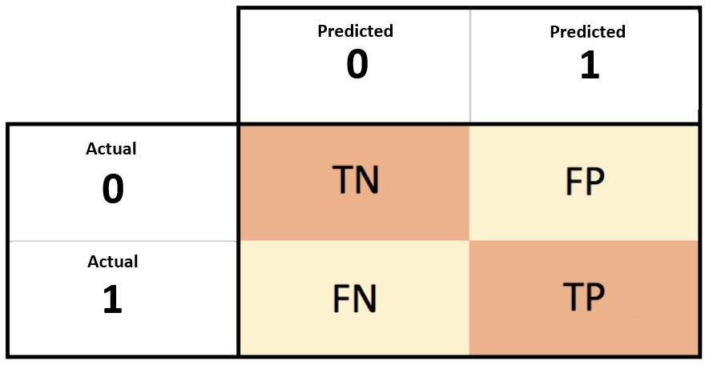
What is accuracy matrix ?
Confusion matrix :
A much better way to evaluate performance of a classifier is to look at the confusion matrix.
Confusion matrix is used to compare predicted and actual values.

Slide 3
Define TN, TP, FP, FN
TP – True Positive : Actual positive and predicted as positive
TN – True Negative: Actual negative and predicted as negative
FP – False Positive: Actual negative and predicted as positive
FN – False Negative: Actual positive and predicted as negative

